Slide 1
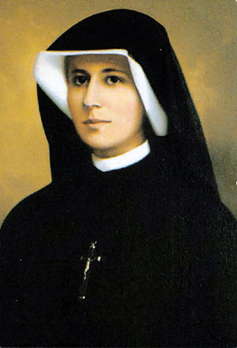
St. Faustina…..

Slide 2
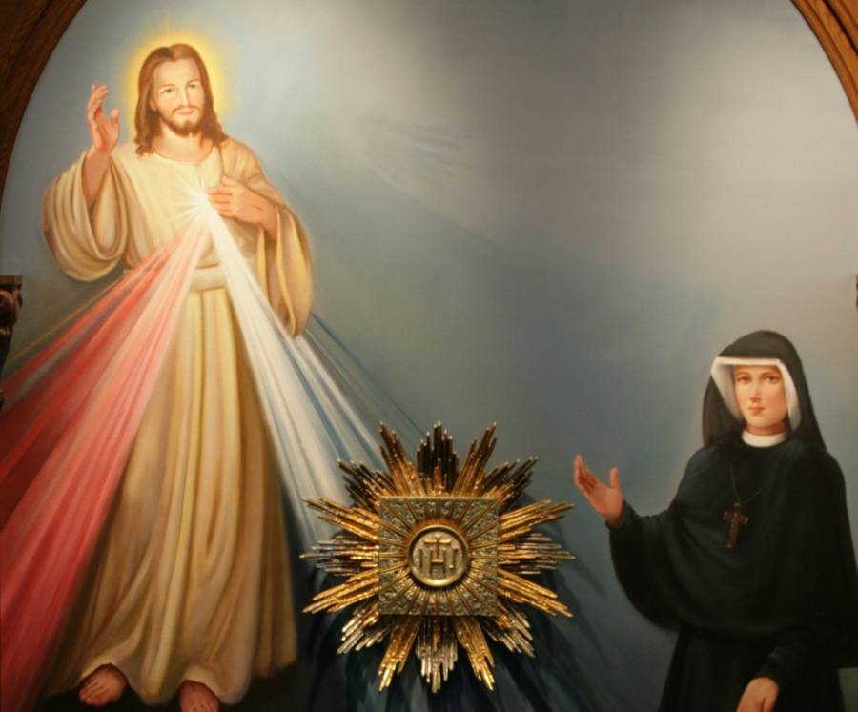
….and the Divine Mercy Chaplet

Slide 3
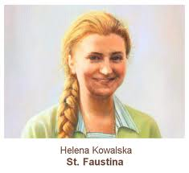
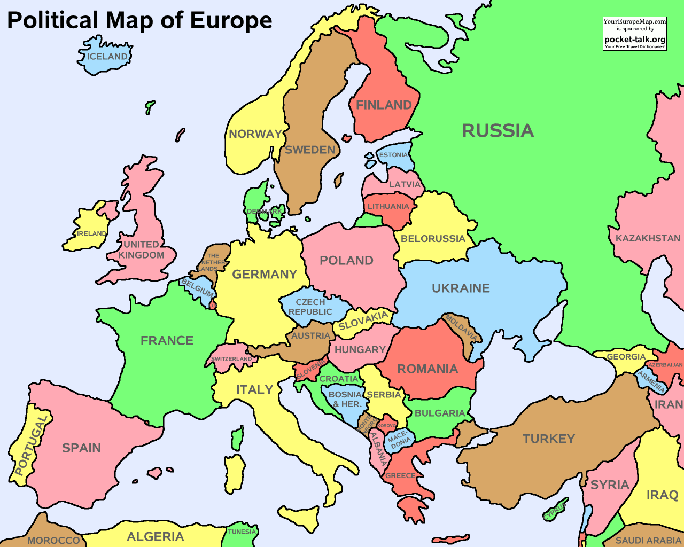
Who was St. Faustina?
Helena Kowalska was born on 25 August 1905. What age would she be now if she was still alive?
She was born in a place called Glogowiec in Poland.
Can you find Ireland and Poland
on the map?

Slide 4
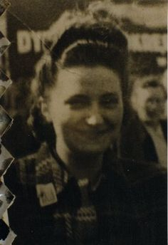
Who was St. Faustina?
She was the third of ten children. She came from a poor family and didn’t get an education.
As a child she felt God calling her to be a nun. She was 20 years old when she could no longer ignore this call.
In 1925, Helena entered the Congregation of Sisters of Our Lady of Mercy. She took the name Faustina.

Slide 5
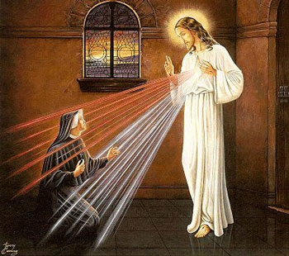
22nd February 1931
On 22nd February 1931, Sr. Faustina was praying in her room when all of a sudden she saw Jesus….

Slide 6
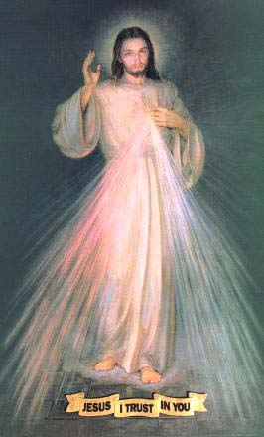

He wore a white robe, and two rays, one white and one red flowed from his heart. The pale ray stands for the Water which makes people clean and pure. The red ray stands for the Blood which gives life to people. These rays flowed out when Jesus’ heart was opened by a lance on the Cross.
Jesus told Sr. Faustina: “Make an image of what you see and write upon it JESUS, I TRUST IN YOU. I want this image to be venerated all over the world.”
Jesus is very happy when we pray with all of our hearts: “Jesus, I trust in You.”

Slide 7
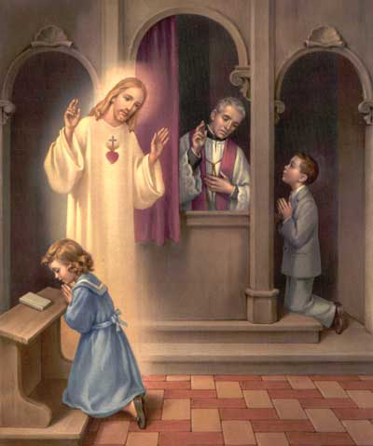
From that moment on, Sr.Faustina dedicated her whole life to telling everyone about Jesus’ mercy. He waits with open arms to forgive us through the priest when we take part in the Sacrament of Reconciliation. His Divine Mercy means that Jesus is always ready to forgive us. We don’t deserve God’s mercy, He gives it to us as a gift once we say we are sorry for our sins.

Slide 8
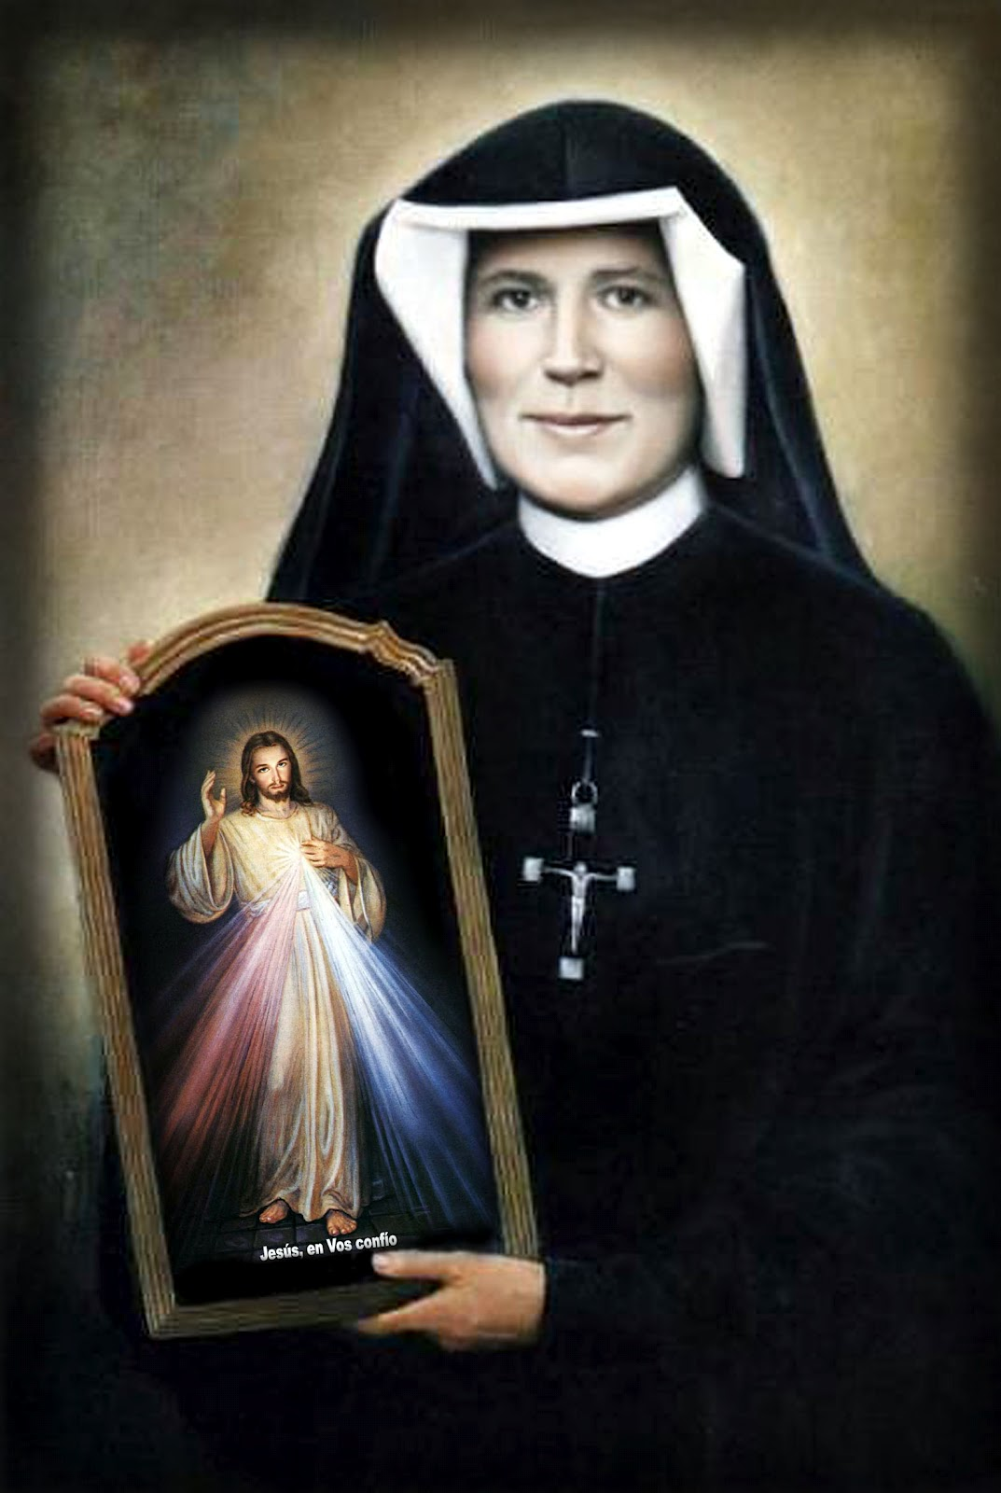
Jesus promised that anyone who honoured this image would go to heaven.

Slide 9
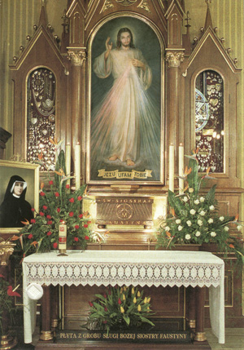
He also told Faustina that He wanted the whole Church to celebrate this great Feast of the Divine Mercy on the first Sunday after Easter.
He asked that a novena to the Divine Mercy would begin on Good Friday and finish on the Feast of Divine Mercy.
How many days are there in a novena?

Slide 10
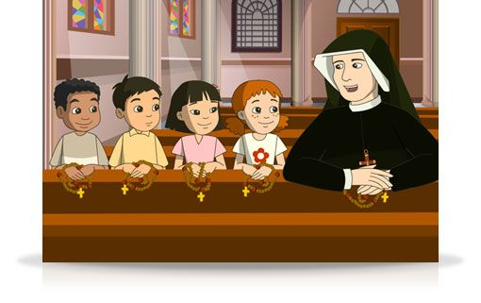
The Divine Mercy Chaplet
He also showed St. Faustina how to pray the Divine Mercy chaplet. When we pray the chaplet, we are offering God, the Father, the sacrifice Jesus made when He died on the Cross to make up for our own sins and the sins of the whole world.

Slide 11
The Divine Mercy Chaplet
You can use your rosary beads to pray the Divine Mercy chaplet.
Bless yourself
Say the Our Father prayer
Say a Hail Mary
Say the Apostles Creed
You can pray the Chaplet with your class along with an animated cartoon of St. Faustina and some children praying the Chaplet at the following link:
http://www.ewtn.com/tv/kids/thedivinemercychapletforkids.asp
You can also view the prayers for the Divine Mercy chaplet at the following webpage: http://www.thedivinemercy.org/message/devotions/praythechaplet.php

Slide 12
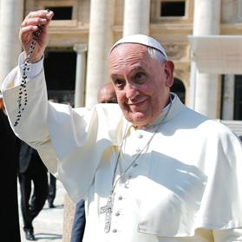
The Divine Mercy Chaplet continued…..
On the single large bead say the prayer:
“Eternal Father, I offer you the Body and Blood, Soul and
Divinity of Your dearly beloved Son, our Lord Jesus
Christ, in atonement for our sins and those of the whole
world.”

Slide 13
The Divine Mercy Chaplet continued…..
On each of the ten smaller beads say the prayer:
“ For the sake of His sorrowful passion..”
and respond with
“Have mercy on us and on the whole world.”
When you have done this 5 times, you have completed the chaplet. You then say the following prayer 3 times.
“Holy God, Holy Mighty One, Holy Immortal One, have
mercy on us and on the whole world.”
Finish by blessing yourself.

Slide 14
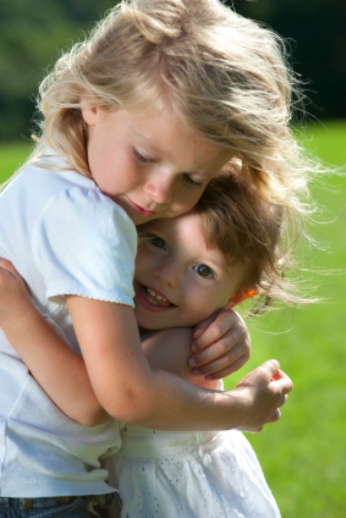
What does Divine Mercy mean?
Divine Mercy is God’s forgiveness when we don’t do what we should e.g. disobeying our parents, not doing our homework, not helping others. We hurt God, others and ourselves when we don’t live as He wants us to.
God wants us to come closer to Him by praying with Him always and offering Him the chaplet for everyone in the world who does not love God.
We must love and forgive others as God loves and forgives us.

Slide 15
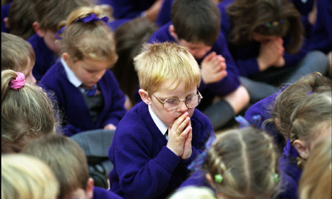
The Three O’ Clock prayer
Jesus asked Sr. Faustina to pray for sinners especially at 3 o’clock in the afternoon, the moment of His death on the cross. This is an hour of great mercy for the whole world. Jesus said: “In this hour, I will refuse nothing to the soul that makes a request of me in virtue of my Passion.”

Slide 16
The Three O’ Clock prayer
Just as you are going home from school, it is a good time to pray to Jesus, thank Him for all that He suffered on the Cross out of love for you and pray for all those who do not know His love.
The following prayer is often said at three o’ clock:
“You expired, O Jesus, but the Source of Life gushed forth for souls and the Ocean of Mercy opened up for the whole world. O Fount of Life, unfathomable Divine Mercy, envelop the whole world and empty yourself out upon us.
O Blood and water, which gushed forth from the Heart of Jesus as a fount of mercy for us, I trust in You.”

Slide 17
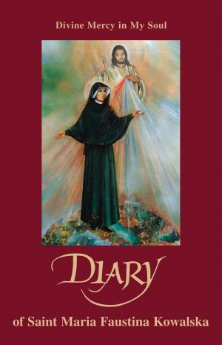
The Diary of St. Maria Faustina Kowalska
Jesus told St. Faustina to write down His message of mercy in a diary. “You are the secretary of My Mercy.”
Her Diary is called ‘Divine Mercy in My Soul.’
Below are some quotes from her diary.

Slide 18
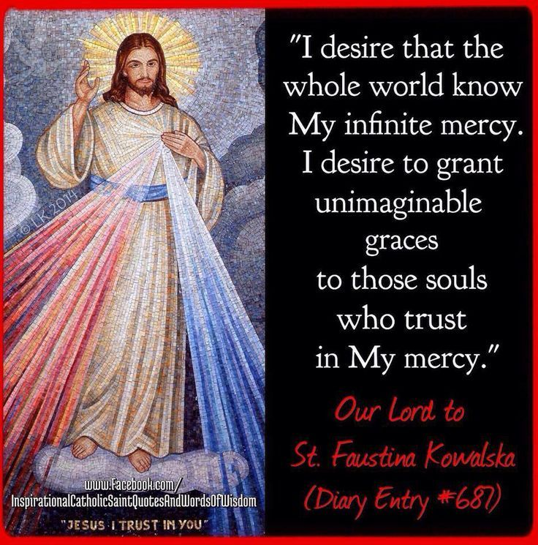

Slide 19
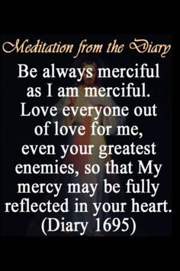

Slide 20
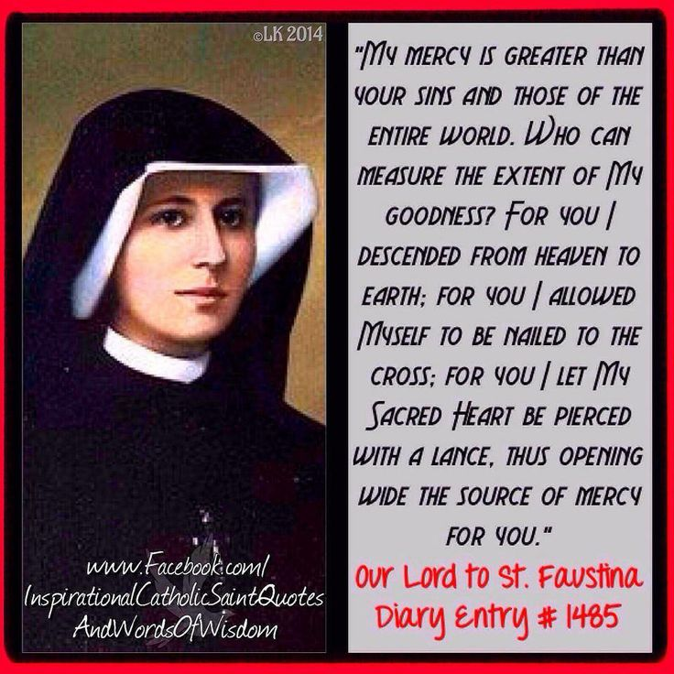

Slide 21
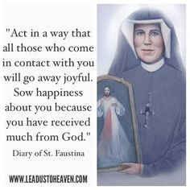

Slide 22
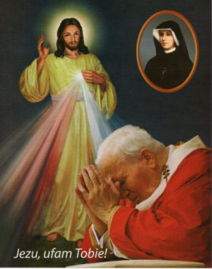
Her death
St. Faustina died of tuberculosis in 1938. What age was St. Faustina when she died?
After her death, the Divine Mercy devotion has grown steadily. With the support of Pope John Paul II, it became popular throughout the entire church.

Slide 23
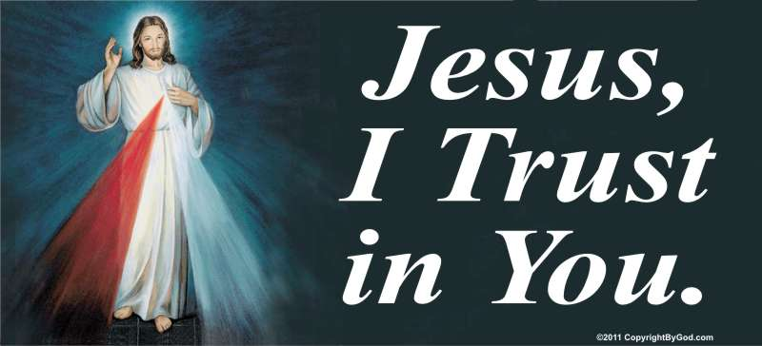

Slide 24
Useful Resources
Pray the Divine Mercy Chaplet with St. Faustina with the following excellent resource: http://www.ewtn.com/tv/kids/thedivinemercychapletforkids.asp
Sing the Divine Mercy Chaplet with the following excellent You Tube video (20 mins): https://www.youtube.com/watch?v=qolkxGqt6JY
Print out a PDF document with all the Divine Mercy Chaplet prayers in 1 page: http://catholicfaith.co.uk/downloads/divinemercy.pdf
Lots of great arts and crafts on St. Faustina and Divine Mercy: http://www.catholicicing.com/divine-mercy-and-st-faustina-crafts-printables-and-more/

