Slide 1
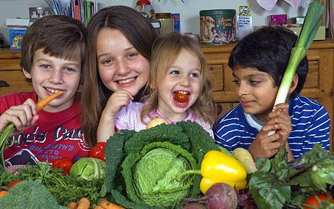
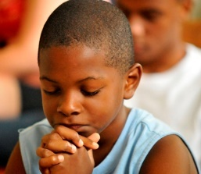
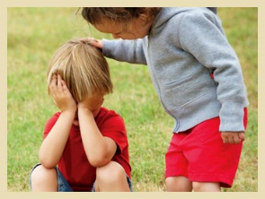
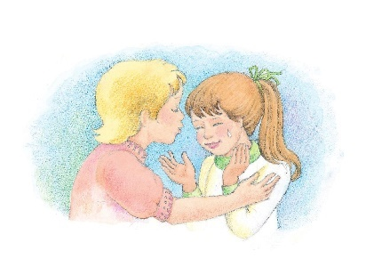
Spiritual Works of Mercy (different ways we can help others grow in God’s love and mercy)

Slide 2
Year of Mercy December 8, 2015 - November 20, 2016
Pope Francis has encouraged us to be more merciful to others during this year.
The Spiritual Works of Mercy are ways we can help ourselves and others to grow spiritually (in their relationship with God).
By doing these Works we are putting into practice what Jesus, our Saviour, asked us to do. We follow Jesus by trying to do these things as often as we can.

Slide 3
The Spiritual Works of Mercy
The 7 Spiritual Works of Mercy are these kind acts by which we help our neighbours with their spiritual needs.
To teach others
Encourage others
Stand up for what is right
Be patient
Forgive others
Comfort others
Pray for the living and the dead

Slide 4
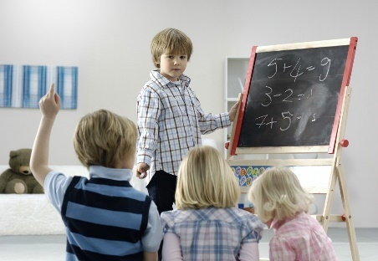
To Teach others (Instruct the ignorant)
I can help my classmates who find it hard to understand and do their work.
I can be patient with my younger brother and sister and explain things to them that they don’t understand.
I can explain to my friend who isn’t a Catholic why I believe in God and why I go to Mass and Confession.
I can become friends with a new classmate and show them how we do things around here.
I can ask a new neighbour to play with me.

Slide 5
Encourage (Counsel the doubtful)
I can say ‘You can do it’ to my classmate who is finding P.E. or something else hard.
If my friend is struggling in their faith I can talk to them about it and encourage them in it.
I can be a good listener to someone who is trying to make an important decision.

Slide 6
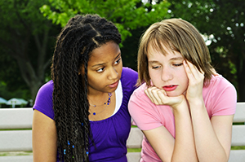
Stand up for what is right (Admonish the sinner)
If someone is being bullied or hurt I can tell the person doing these things to stop.
I can say to my friend that it is wrong to lie to their parents, to cheat, to steal etc.
I can set a good example by owning up if I’ve done something wrong and by saying sorry.
I can stand up for my faith if someone is laughing at it.

Slide 7
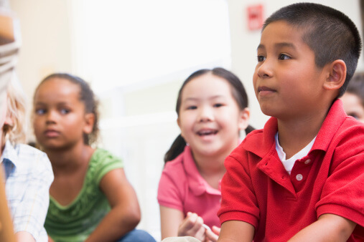
Be Patient (To bear wrongs patiently)
Sometimes I get blamed for something that wasn’t my fault. I can explain what happened and then move on.
I can find some people annoying but I can make a special effort to be nice to them even though I don’t feel like it. I can say to Jesus ‘I offer this up to you to say thank-you for dying on the cross for me and opening the gates of heaven’.

Slide 8
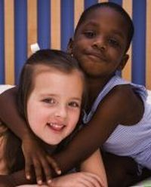
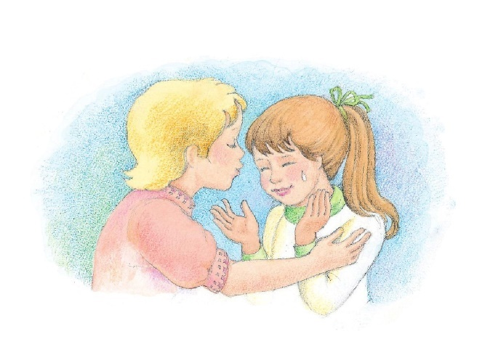
Forgive others (To forgive offences willingly)
People sometimes say and do wrong things to me. When they say sorry I need to forgive them and not hold it against them.
I need to encourage my friend to forgive someone who has hurt her/him even if that person doesn’t say they are sorry.

Slide 9
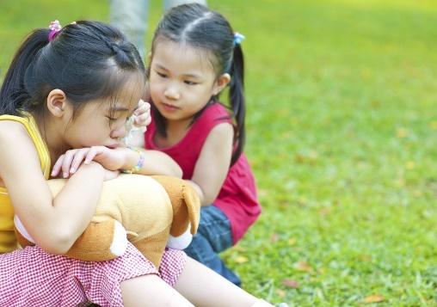
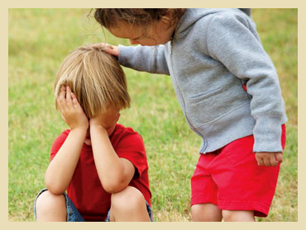
Comfort others (Comfort the afflicted)
If my friend has lost something precious I will try to say comforting words and give a hand to help them find it.
I can put my arm around someone who is hurting.
I can listen to someone who wants to talk about how they are hurting.
I can remind my friend to talk to Jesus about how they are feeling and He will comfort them too!

Slide 10
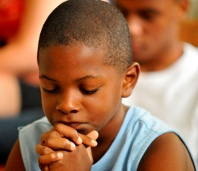
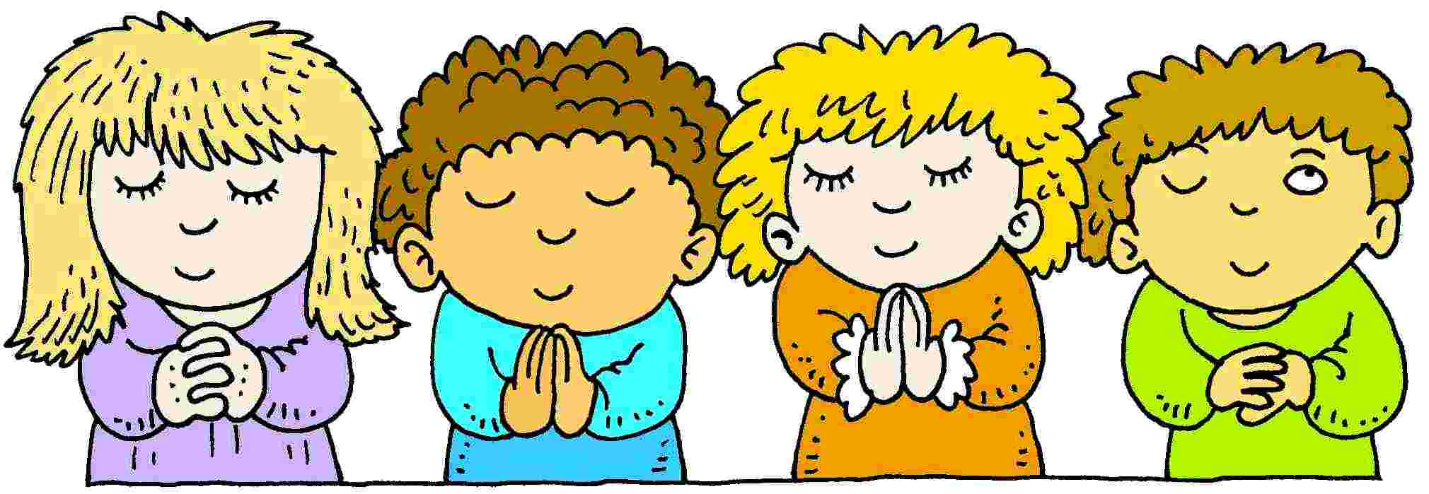
Pray for the living and the dead
Lots of people I know need prayers: those doing exams, sick people, my parents, my brothers and sisters, my teacher. Everyone needs prayers!
It is good to pray for those who have died so that God will welcome them into heaven.

Slide 11
Revision time!
There are 7 Spiritual Works of Mercy, can you remember them?

Slide 12
Free activity
For free, downloadable, child friendly, colouring booklets on the Spiritual Works of Mercy click on the following link:
http://looktohimandberadiant.blogspot.ie/2015/07/spiritual-works-of-mercy-teaching-tools.html

