Slide 1
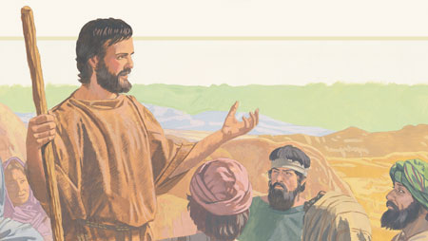
John the Baptist Feast Day 24th June

Slide 2
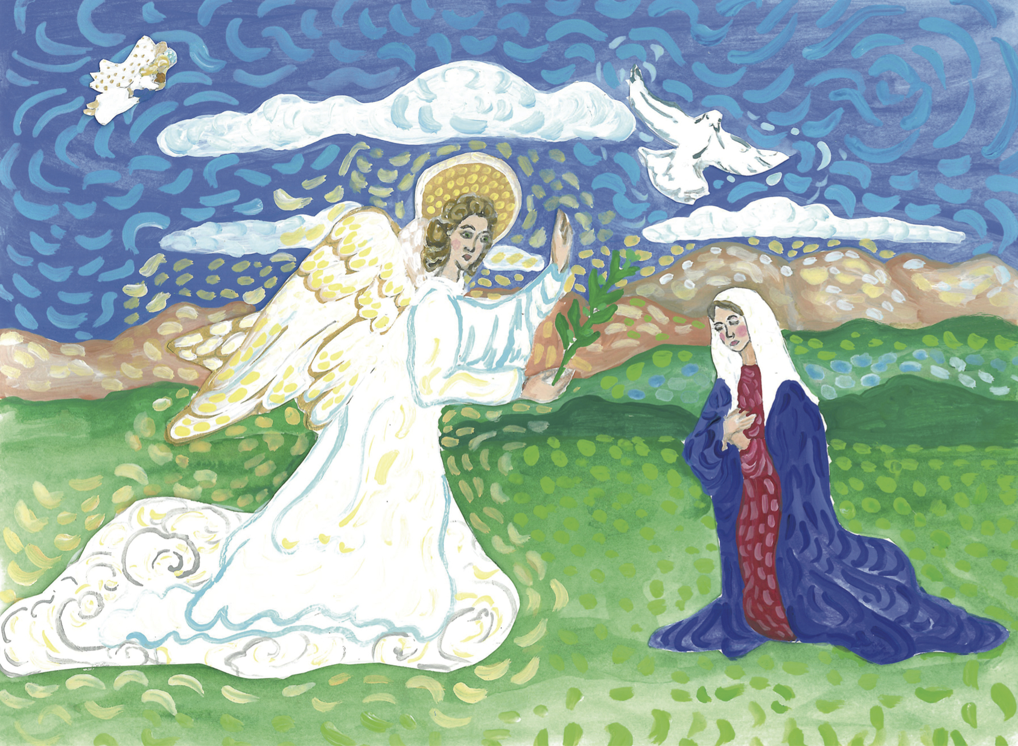
When the Angel Gabriel appeared to Mary and told her she would have a baby called Jesus, the angel also told her that her cousin Elizabeth would have a baby.

Slide 3
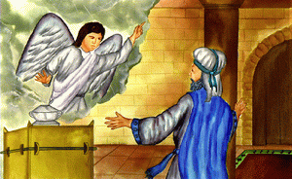
Zechariah was Elizabeth’s husband. He was a Jewish priest. One day when he was performing his duties, the angel Gabriel appeared to him. The angel told him that he and his wife Elizabeth would have a baby called John.

Slide 4
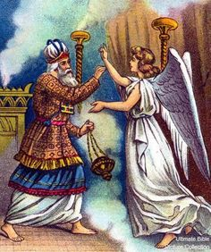
However, Zechariah did not believe the angel. From that moment on, Zechariah was unable to speak. It must have been very hard for Zechariah to believe because both he and Elizabeth were very old. How could they possibly have a baby? Yet EVERYTHING is possible to God.

Slide 5
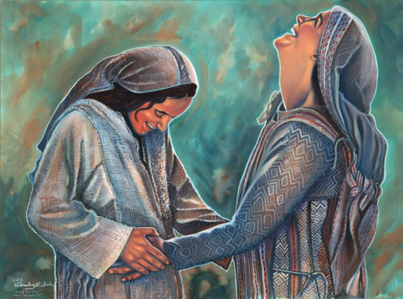
Meanwhile, Mary who was pregnant with Jesus made a visit to see her cousin Elizabeth. The moment Elizabeth heard Mary’s greeting, the child in her womb leaped for joy.
In a loud voice Elizabeth exclaimed: “Blessed are you among women, and blessed is the child you will bear! But why am I so favoured, that the mother of my Lord should come to me? As soon as the sound of your greeting reached my ears, the baby in my womb leaped for joy.” (Lk1:42-44)

Slide 6
This is the place near Jerusalem, Israel where Mary went to visit her cousin Elizabeth.
Mary made this long journey from Nazareth to visit her cousin Elizabeth. What could you do to help and support your family, friends and relations?

Slide 7
This is the place where John the Baptist was born.

Slide 8
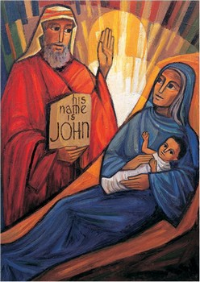
When Zechariah and Elizabeth’s baby was born, they were trying to decide on a name. Zechariah wrote down on a piece of paper-”His name is John” From that moment on, Zechariah was able to speak again.

Slide 9
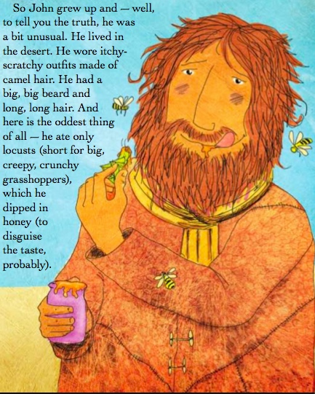

Slide 10
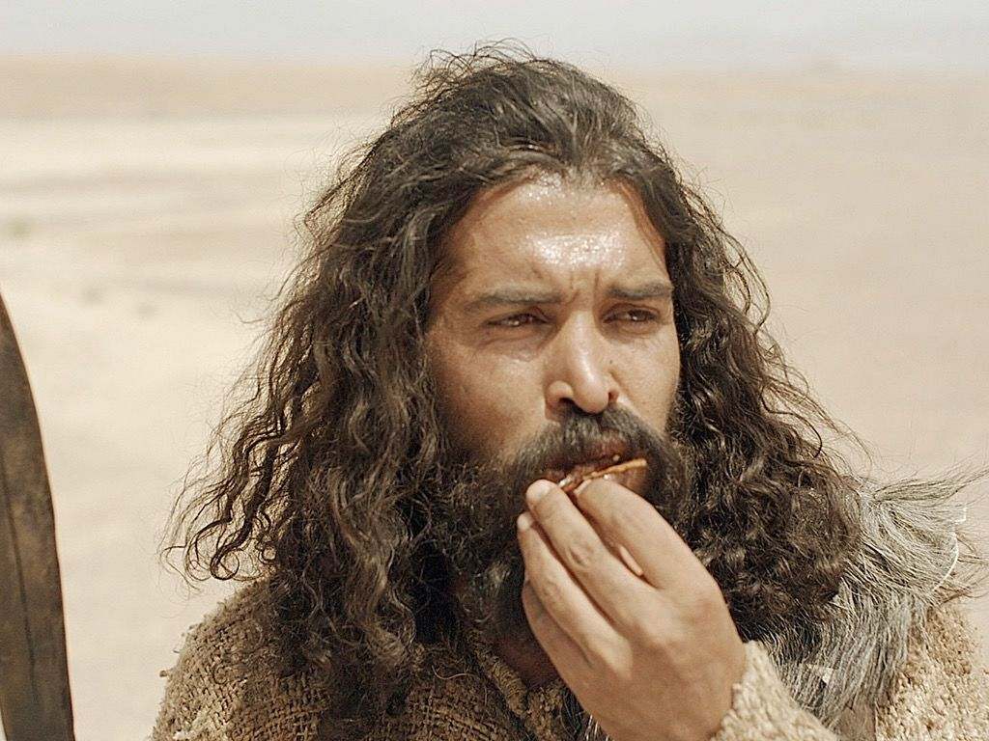
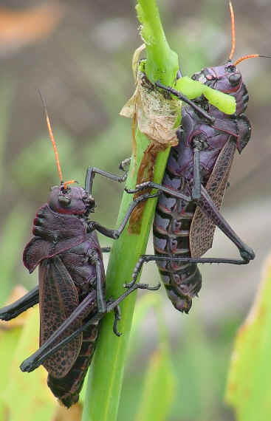
Why do you think John chose to live his life like this?
When you are older would you consider living a simple life like this?
John became a preacher. He told people all about God. Would you tell people about God?

Slide 11
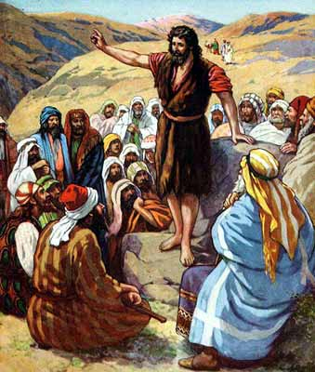
John prepared the way for Jesus. There were a lot of people who had done bad things in their lives and he invited them to change their ways and ask God for forgiveness. Many people listened to John.

Slide 12
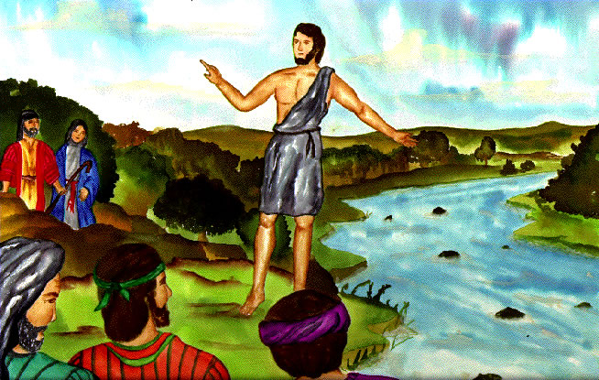
People came to John to be baptised in the river Jordan. Many people were wondering was he the Saviour who they had been waiting for.
John answered them: "I baptise you with water, but One more powerful than I will come, the straps of whose sandals I am not worthy to untie. He will baptise you with the Holy Spirit and with fire.” (Lk 3:16)

Slide 13
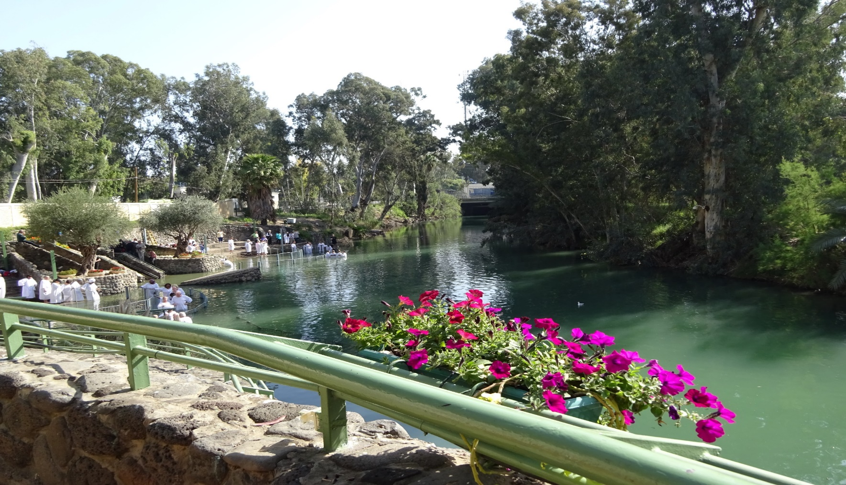
Who do you think John the Baptist was talking about?
This is a photograph of the River Jordan today.

Slide 14
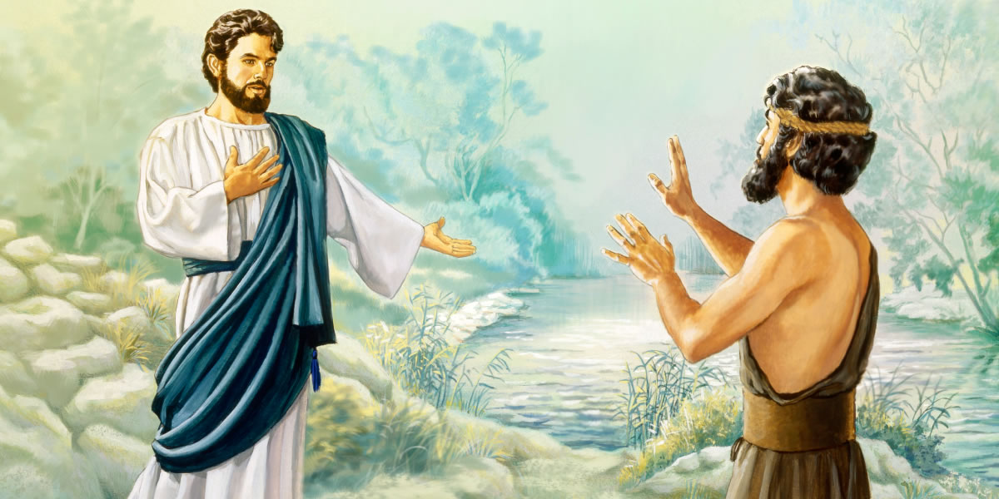
John continued to preach and baptise people until one day Jesus came by to be baptised. John didn't know what to say. All he thought was, "how could I, just a regular man baptise Jesus the Saviour of the world?"

Slide 15
John said to Jesus, "You should be baptising me. I cannot baptise you Lord."
Jesus replied, "It's important that I do this now. I am ready and I want to be an example to others."
So John took Jesus and baptised Him. He placed his hand on His back and laid him down into the water until He was covered. Then he brought Him back up again. As soon as Jesus was baptised the sky opened up and the Holy Spirit came upon Him like a beautiful white dove. Then a voice from heaven said, "This is my Son, I love him and I am pleased with him."

Slide 17
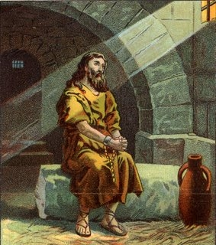
Following his baptism of Jesus, John's popularity grew so much that King Herod got concerned. Herod ordered him to be arrested and imprisoned. He wanted to kill John but he was afraid of the people, because they believed John was a prophet.
When it was King Herod’s birthday, he promised to grant his daughter any wish. His daughter asked for the head of John the Baptist. King Herod kept his promise. John the Baptist died sometime between 33 and 36 AD.

Slide 18
Prayer
Dear God, thank you for the life of St. John the Baptist. He prepared the way for Jesus and spent his whole life telling people about God. Help me to live a simple life like St. John the Baptist and to be always ready to tell others about God. Amen.

Slide 19
John the Baptist and Jesus- Painting by Greg Olsen

Slide 20
Youtube video
https://www.youtube.com/watch?v=uf_ahdSQGtg
Activities
http://www.sermons4kids.com/messenger_sent_from_god.htm
More Great Activities
http://sundayschoolzone.com/bible-story/john-the-baptist/

